Slide 1

Effect of Education on Yearly Compensation- Evidence from the Apple and Amazon companies
Khem Raj Bhatt

Slide 2

“Sufficiently advanced technology is indistinguishable from magic”
- Arthur C. Clarke

Slide 3
Overview
Analyzing the effect that having a masters degree has on total yearly compensation of Software Engineers, at both Amazon and Apple.
Specifically, analyzing - what will be the effect on our yearly compensation when you are a software engineer, and you are working on Amazon or Apple, given your education level?
As per my knowledge, I didn’t get any literatures related to study of compensation of software engineers segregating into technological and non-technological companies. So, I chose to take this topic.

Slide 4
Data Overview
Data was collected from the site levels fyi
Dataset originally contained 1,67,642 observations and 29 variables
Removed all Null and unnecessary data nonrelated to our analysis
The variables contains the total compensation, years of experience, gender, education and many more
Restricted the data to two companies which are Amazon and Apple
Also restricted it to locations with the United States
Total analysis observations was 1,421 observations and 18 variables

Slide 5
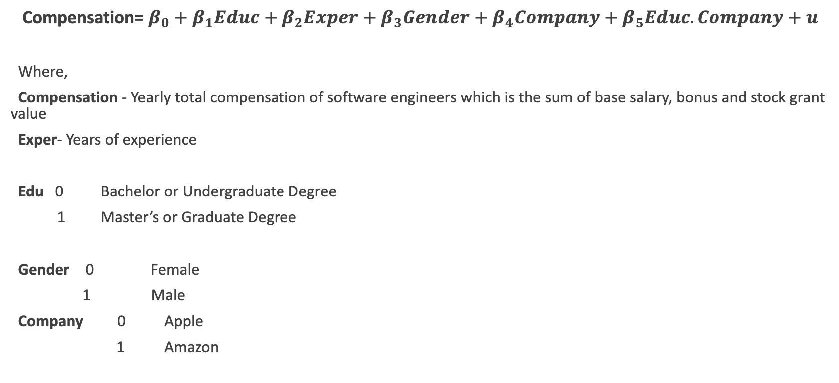
Model Overview
Compensation= $β_{0}+β_{1}Educ+β_{2}Exper+β_{3}Gender+β_{4}Company+β_{5}Educ.Company+u$
Where,
Compensation - Yearly total compensation of software engineers which is the sum of base salary, bonus and stock grant value
Exper- Years of experience
Edu 0 Bachelor or Undergraduate Degree
1 Master’s or Graduate Degree
Gender 0 Female
1 Male
Company 0 Apple
1 Amazon

Slide 6
Hypothesis
H_{o} : Master’s Degree has no effect on yearly compensation of an employee
H₁: Master’s Degree has effect on yearly compensation of an employee

Slide 7

Multiple Linear Regression Using (OLS)

Slide 8
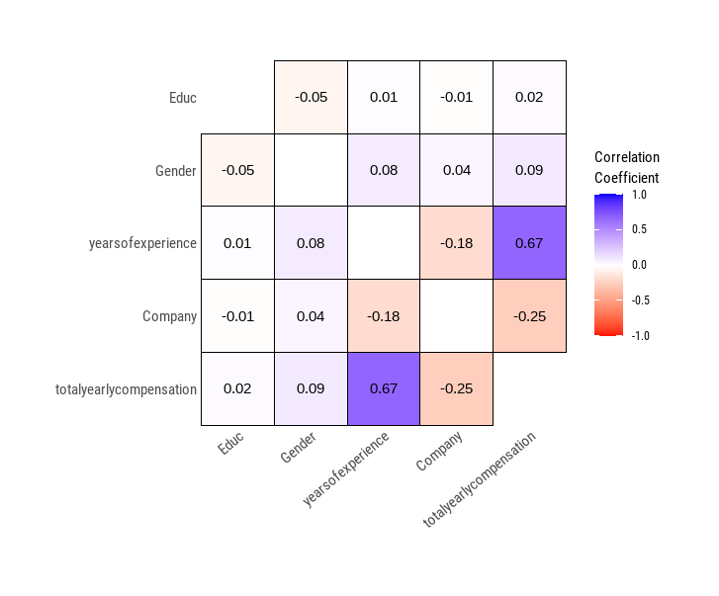

Multicollinearity Test
VIF Results
Correlation Matrix

Slide 9

Heteroskedasticity Test

Slide 10

Multiple Linear Regression Using (WLS)

Slide 11

Heteroskedasticity Test

Slide 12
Education has a significant impact on yearly compensation for both companies. Since, education is dummy variable, so it means Master’s degree has positive impact on yearly compensation on both the companies
In comparison to companies, Apple pay more to its employees based on education level than Amazon.
Years of experience too have substantial impact on yearly compensation level.
Gender has no significant impact on yearly compensation.
Conclusions

